Slide 1
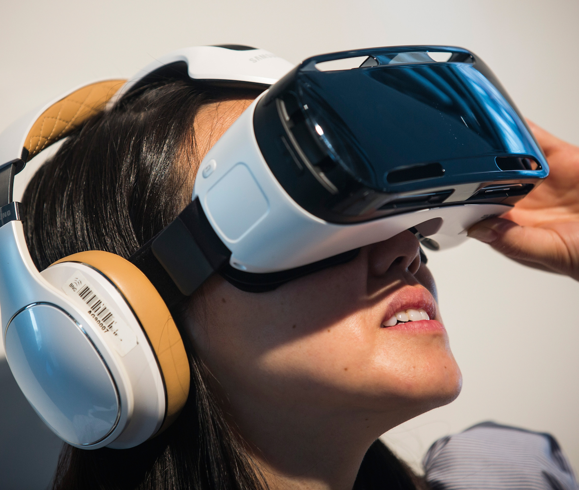
The New Reality, Virtual Reality
By: Gregg Gorstein
This Photo by Unknown Author is licensed under CC BY-SA

Slide 2
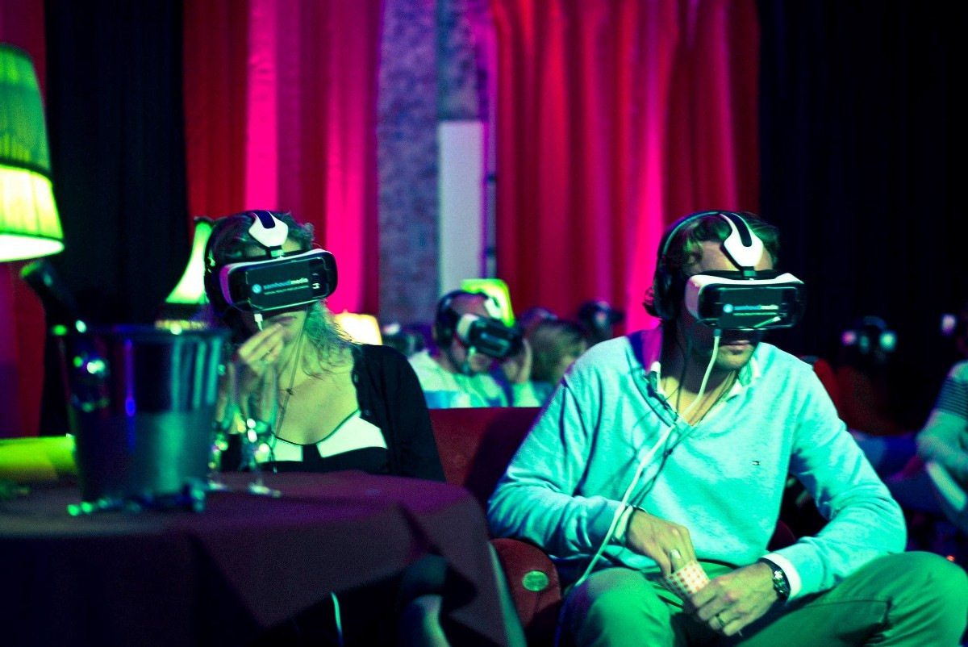
VR’s Changes In Relationships
Benefits
Helps Maintain Relationships
Saves Long Distance Relationships
Helps People Meet New People Without Risk
Virtual Therapy
Negatives
Ruins Quality of Relationship (Face-to-Face) bond.
Less Productivity
Subject People To Reveal More Personal Data
This Photo by Unknown Author is licensed under CC BY

Slide 3




VR’s Changes to How We Work
Potential Outcomes
VR Games = Less Job Participation
Changes in Training Employees
Remote Chatrooms
More Applications

Slide 4
VR’s Change to Entertainment
Reveltuotinizes Watching Sports
Expereinces from Home
Traveling

Slide 5
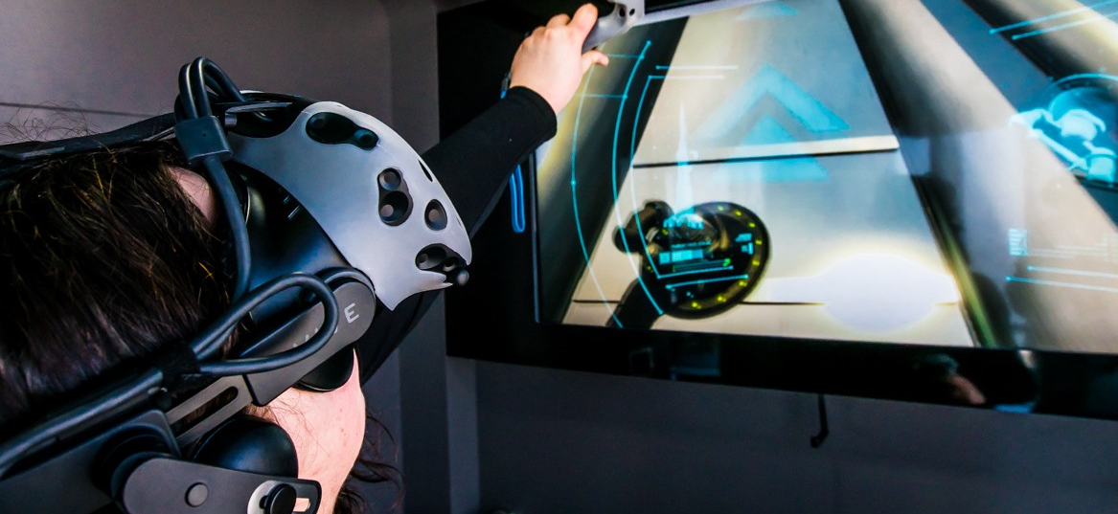
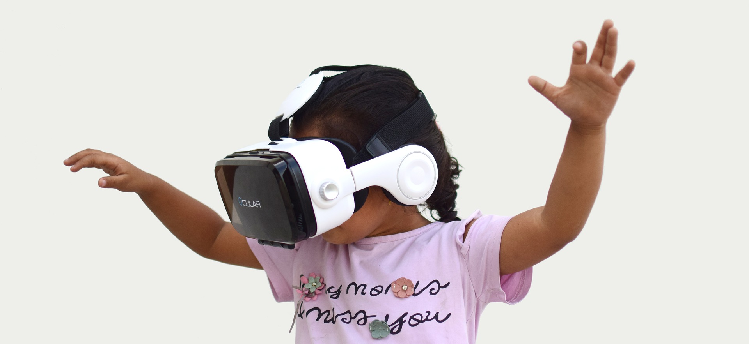
VR’s Change to Social Insitutions
Help Job Training
VR for Educational Purposes
This Photo by Unknown Author is licensed under CC BY
This Photo by Unknown Author is licensed under CC BY-SA

Slide 6
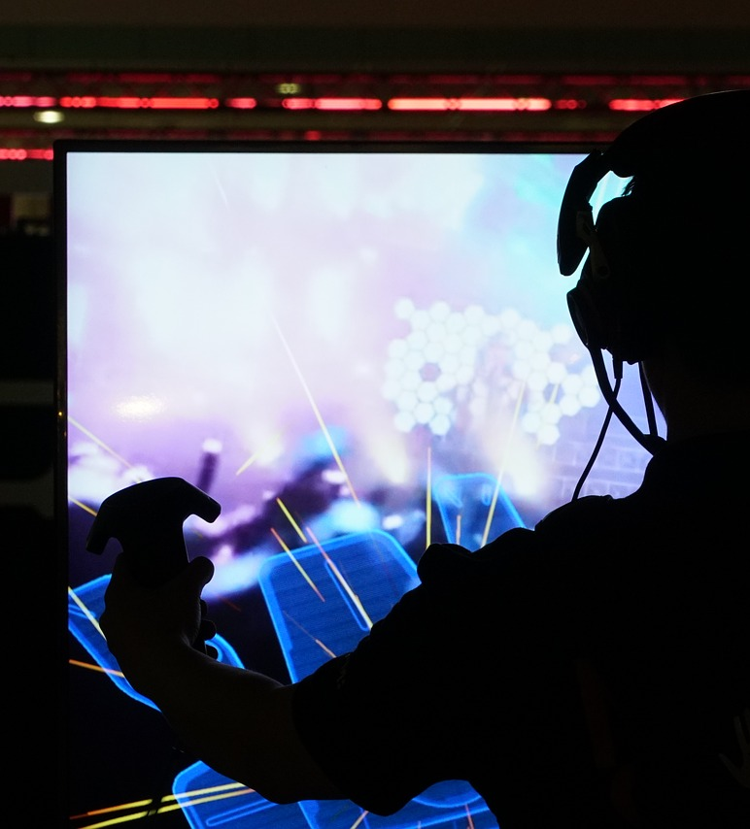
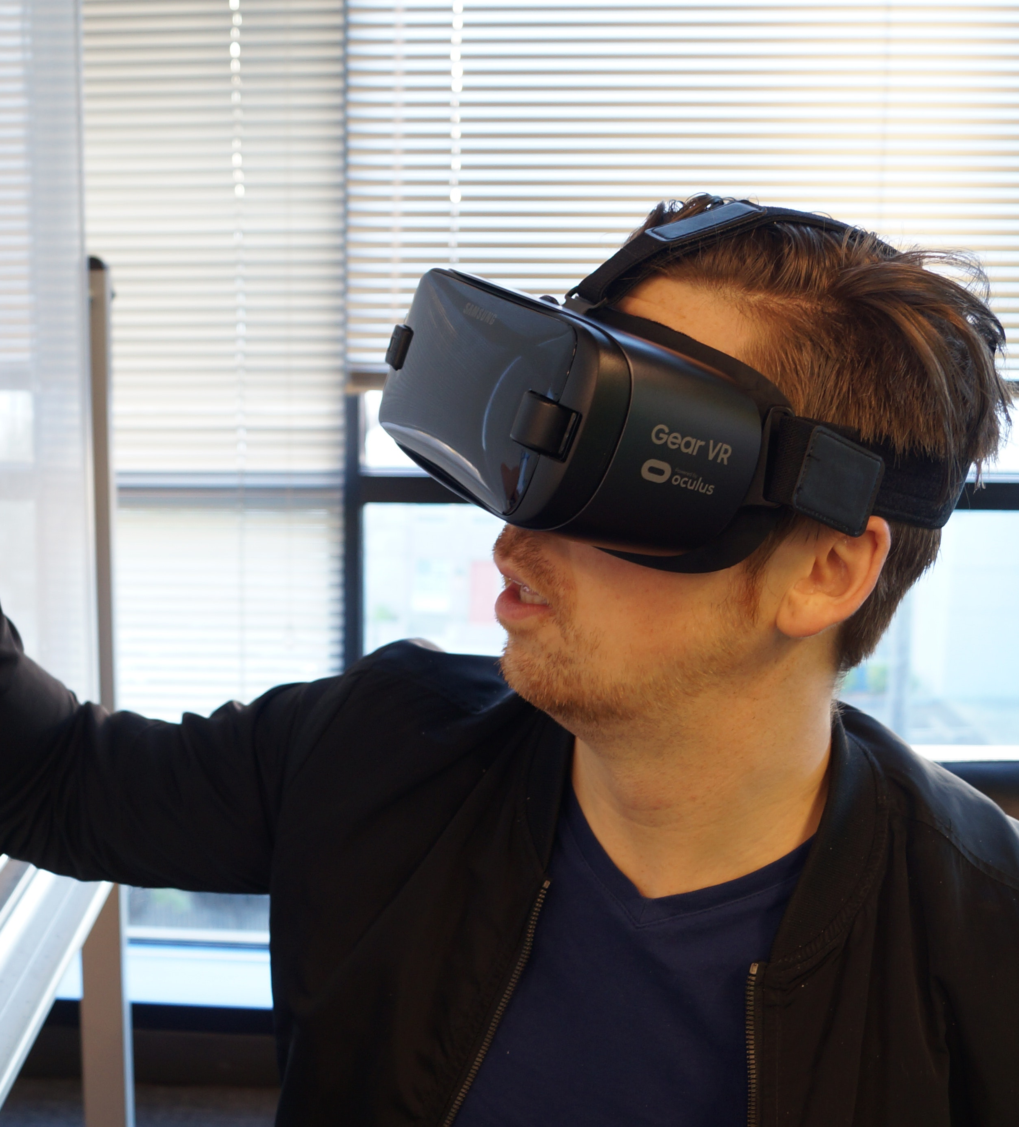
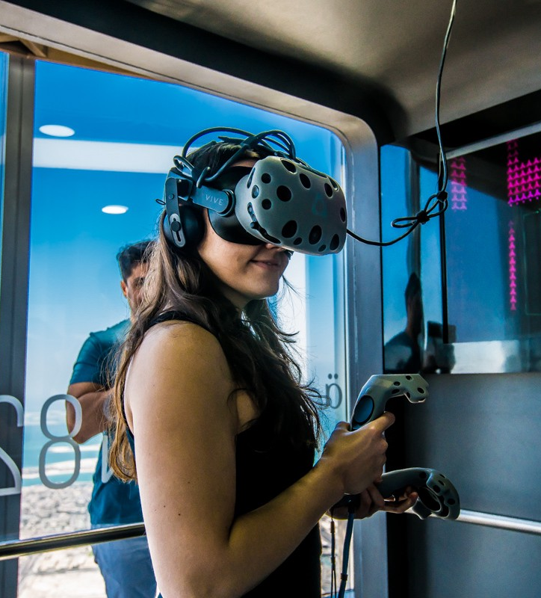
VR is Disruptive
This Photo by Unknown Author is licensed under CC BY

